Slide 1
Deictic Directionality Exponents in Emai
Ronald P. Schaefer
and
Francis O. Egbokhare
SWL VIII

Slide 2
Probably, most of you are aware of the recent discussion and series of articles concerned with the relation between language-particular and cross-linguistic comparative categories (LT 2016, 20[2]: 297-462). Deictic directionality and its polar exponents seem to be a useful example of tensions underlying this relation.
Although deictic directionality has received attention in the literature, it has done so with an assortment of terms. Among these are:
andative, itive, translocative, altrilocal, centrifugal for one pole
and
venitive, cislocative, equilocal and centripedal for the second pole.
We are not going to expand the terminology for deictic directional phenomena. But we will employ andative and venitive as terms for the opposing poles of directionality we have encountered.

Slide 3
The expression of motion remains a topic of linguistic investigation under various guises. Associated motion, for instance, has been re-invigorated of late with typological studies of South America’s Amazonian basin (Koch 1984, Guilliame 2016). Translational motion studies have drawn inspiration for a number of decades from (Talmy 1985, 1991, 2000).
Still another area of study has concerned deictic directionality. Most often, the exponents of this term are studies as motion toward or away from a deictic center (Hooper 2002).
Today we examine deictic directionality (DD) exponents in Nigeria’s minority language Emai (Edoid, West Benue Congo and Niger Congo, Williamson and Blench 2000). Relatively strict SVO, Emai manifests lexical and grammatical tone, little segmental inflection and few prepositions. In simple predicates, it employs intransitive, transitive and ditransitive verbs, as well as complex predicates with verbs in series or verb plus particle nexus.

Slide 7
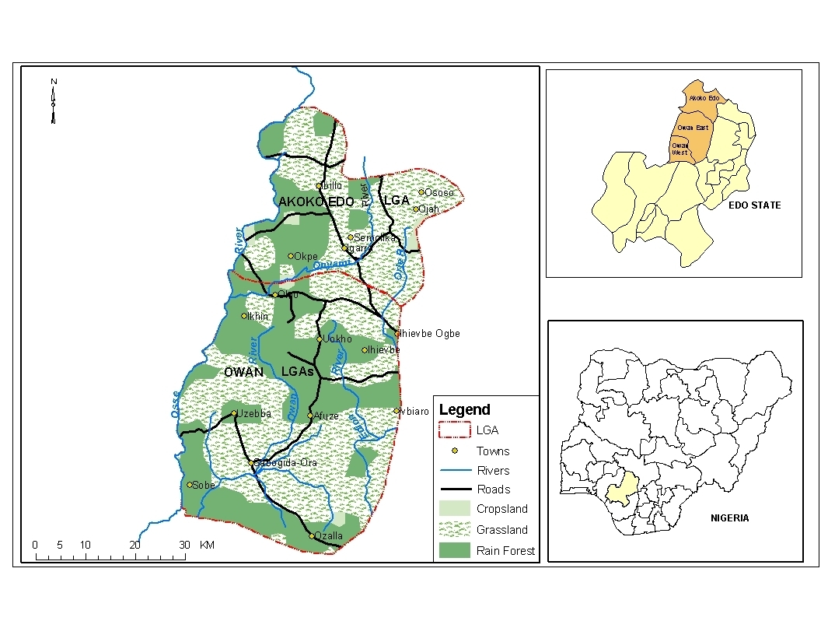

Slide 9
In Emai the coding of deictic directionality, although a type of motion, is distinct from that of translational motion (a figure moving with respect to a ground/landmark) and deictic translational motion (a figure moving with respect to a deictic reference point).
Regarding translational motion, Emai conflates Motion+Path in verbs that occur in simple predicates as well as in series with a Manner verb in a complex predicate.

Slide 10
1 a. òjè ó vbí ékéín ímè.
Oje PRP.enter LOC inside farm
‘Oje entered the farm.’
b. ólí ómò ò ó làgáá ùhàì.
the child SC C move.round well
‘The child is moving around the well.
2 a. òjè lá ó vbí ékéín ímè.
Oje PRP.run enter LOC inside farm
‘Oje ran into the farm.’
b. ólí ómò lá lágáá ùhàì.
the child PRP.run move.round well
‘The child has run around the well.

Slide 11
Regarding deictic motion, Emai has several forms that express Motion+Deictic Path. These are the equivalents of English ‘come’ and ‘go.’ They consist of lode ‘go,’ vare ‘come’ and vade ‘come.’
3 a. ólì òkpòsò lódé vbì ìwè.
the woman CONT.go LOC house
‘The woman is going to the house.’
b. ólì òkpòsò váré vbì ìwè.
the woman PRP.come LOC house
‘The woman has come to the house.
c. ólì òkpòsò vádè vbí ímè.
the woman CONT.come LOC farm
‘The woman is coming to the farm.’

Slide 12
In Emai, deictic directionality is coded by venitive (VN) re and andative (AN) a.
Both combine with verbs, as do other postverbal particles that have functions bearing on valency conditions or aspectual state.
In some respects, this particle set appears to cover much of the same semantic terrain that characterizes Bantu verbal suffixes or extensions, as discussed in Hyman (2007), Schadeberg (2003), among others.
The Emai particle set includes the valency forms: Applicative li, Change of Location o and Projected Adherence e.

Slide 13
4 a. ólì òkpòsò shén émà lí ònwìmè.
the woman PRP.sell yam APP farmer
‘The woman has sold yam to a farmer.’
b. ólì òkpòsò nwú émà ó vbí úkpódè.
the woman PRP.carry yam CL LOC road
‘The woman has put yam onto the road.’
c. òjè óhó ólì úshé'n kú é ólì òkpòsò.
Oje PRP.blow the powder disperse PAD the woman
‘Oje blew the powder all over the woman.’

Slide 14
The set also includes an aspectual form: Temporal Perspective lee.
5 a. òjè ò ó è ólí émáé lèé.
Oje SC C eat the food TEMP
‘Oje is already eating the food.’
b. òjè é ólí émàè léé.
Oje PRP.eat the food TEMP
‘Oje has already eaten / finished off the food.’

Slide 15
This closed-class particle set is largely heterosemic, combining a change and a non-change function under a single form.
Such is the case with Applicative li, which has senses related to a change of possession recipient and a non-change benefactive. It is only the latter sense that exhibits combinatorial potential with other particles.
6 a. òjè ré óbò ó vbí ébè lí àlèkè.
Oje PRP.put finger CL LOC paper APP Aleke
‘Oje signed the paper for Aleke.’
b. òjè ò ó fòò ólí ómí á lì àlèkè.
Oje SC C cool the soup AN APP Aleke
‘Oje is cooling down the soup for Aleke.’

Slide 16
The Emai deictic directional particles interact with a variety of monovalent and bivalent verbs, although not with trivalent verbs.
The resulting complex predicates are not limited to the expression of motion, as we often see in the literature.
Venitive and andative predications also code events of cognition change as well as change of material state.
The particles semantic effect appears derivational or confirmative with regard to meaning components of its accompanying verb.
In some instances meanings arise that are not part of that verb; in others a particle articulates a component of meaning resident in a verb but not asserted by it.

Slide 17
We now turn to a brief survey of the distributional character of venitive re and andative a.
We examine their distribution with respect to the transitivity of their accompanying verb as well as event type of the resulting complex predication.

Slide 18
Table 1. Summary of distributional behavior of Emai DD particles and their semantic effect as derivational or confirmative with regard to meaning of the accompanying transitive or intransitive verb.
 |  | DERIV |  |  | CONFIRM
 |  | re | a |  | re | a
MOT | TR | + | + |  | + | -
 | INTR | - | + |  | + | -
RET ST | TR | + | - |  | - | -
 | INTR | + | - |  | - | -
DC | TR | - | - |  | + | -
 | INTR | - | - |  | - | -
CH ST | TR | - | + |  | + | +
 | INTR | + | + |  | + | +
FIGUR | TR | + | + |  | - | -
 | INTR | + | + |  | - | -

Slide 19
I. MOTION (change of position or location)
PARTICLE re Transitive (some Intransitive)
1a. òjè shíé ólí úì ré. confirmatory
Oje PRP.coil the rope VN
‘Oje wound / coiled up the rope.’
b. ólí úkpúì shíé ré'.
the rope PRP.coil VN
‘The rope got wound / coiled up.’
c. òjè shíé ólí úì ó vbí óràn.
Oje coil the rope CL LOC pole
‘Oje wound / coiled the rope onto the pole.’

Slide 20
2 a. ólí ókpósó nwú' émà ré. derivational
the woman PAP.carry yam VN
‘The woman brought yam.’
b. ólì òkpòsò nwú émà.
the woman PRP.carry yam
‘The woman carried yam / *brought yam.’
c. ólí ókpósó zé' èkèn ré.
the woman PAP.scoop sand VN
‘The woman brought sand.’
d. ólí ókpósó zé' èkèn.
the woman PAP.scoop sand
‘The woman scooped sand.’

Slide 21
I MOTION
PARTICLE a
Transitive (some Intransitive)
1 a. òjè gbáán òú à. derivational
Oje PRP.wind thread AN
‘Oje unwound the thread.’
b. ólì òú gbáán à.
the thread PAP.wind AN
‘The thread got unwound.’
c. òjè ò ó gbààn òú.
Oje SC C wind thread
‘Oje is winding thread.’

Slide 22
2a. ólí ómòhè fí ólì òkpòsò á. derivational
the man PRP.leave the woman AN
‘The man has left the woman behind.’
b. *ólí ómòhè fí ólì òkpòsò.
the man PRP.leave the woman
‘The man has left the woman.’

Slide 23
MOTION
PARTICLE a Intransitive
Ø examples

Slide 24
II MAINTAIN RETENTIVE STATE
(with potential for movement restrained)
remain in view not just move into view

Slide 25
PARTICLE re
Transitive (some Intransitive)
1a. ólí ómòhè kóó émàè ré. derivational
the man PRP.leave food VN
‘The man left food.’
b. ólí émàè kóó ré'.
the food leave VN
‘The food remained / stayed / There was food left.’
c. àlèkè kóó émàè ré lí òjè
Aleke PRP.leave food VN APP Oje
‘Aleke left food for Oje’
d. òjè ò ó kò òwàà.
Oje SC C stroll direct.course
‘Oje is taking a direct course on his stroll.’

Slide 26
II MAINTAIN RETENTIVE STATE
PARTICLE a
Transitive or Intransitive
Ø examples

Slide 27
III NATURE DEICTIC CENTER
PARTICLE re
Transitive

Slide 28
1a. ólí ómò búú mè ré. confirmatory
the baby PRP.approach me VN
‘The baby approached me.’ (here where I am)
b. *ólí ómò búú é ré.
the baby PRP.approach you VN
‘The baby approached you.’
c. ólí ómò búú óì /é / ólì òkpòsò.
the baby PRP.approach her you the woman
‘The baby approached her / you / the woman.’
d. *ólí ómò búú óì / ólì òkpòsò ré.
the baby PRP.approach her the woman VN
‘The baby approached her / the woman.’

Slide 29
III NATURE DEICTIC CENTER
PARTICLE a
Transitive or Intransitive
Ø examples

Slide 30
IV CHANGE OF STATE
PARTICLE a
Intransitive
1 a. ólí éànmì áá á'. confirmatory
the meat PRP.rot AN
‘The meat has rotted away.’
b. ólí éánmí ló àà ó vbí ògò.
the meat PRED rot CL LOC bush
‘The meat will decompose in the bush.
c. ólì ìtásá ó ò àá.
the bowl SC C leak
‘The bowl leaks.’

Slide 31
PARTICLE a Transitive (some Intransitive)
1 a. òjè khúyé ólí úkhùèdè á. derivational
Oje PRP.close the door AN
‘Oje opened the door.
b. ólí úkhùèdè khúyé á'.
the door PRP.close AN
‘The door got opened.’
c. òjè khúyé ólí úkhùèdè.
Oje PRP.close the door
‘Oje closed the door.’
d. ólí úkhùèdè khúyé-ì.
the door PRP.door-F
‘The door closed.’
.

Slide 32
2 a. ólí óvbèkhàn gbé ólí ákhè á. derivational
the youth PRP.break the pot AN
‘The youth broke the pot.’
b. ólí ákhè gbé á'.
the pot PRP.break AN
‘The pot got broke.’
c. ólí óvbèkhàn ò ó gbè ólí ómòhè.
the youth SC C beat the man
‘The youth is beating /hitting the man.’
d. ólí ómòhè gbé ólì ìbè.
the man PRP.beat the drum
‘The man beat / played the drum.’
e. òjè ò ó gbè ábò.
Oje SC C hit hands
‘Oje is clapping his hands.’

Slide 33
3 a. ólì òkpòsò fú-nó ùrùkpà á. derivational
the woman PRP.extinguish-DS lantern AN
‘The woman extinguished / quenched the lantern / the light.’
b. ólì ùrùkpà fúnó á'.
the lantern PRP.extinguish AN
‘The lantern got extinguished / quenched.’
c. ólì òkpòsò fú éghó' ísì òí á.
the woman PRP.waste money ASS her AN
‘The woman wasted her money.’
d. ìbòbòdí fú ó vbí ímè.
cassava PAP.waste CL LOC farm
‘The cassava wasted on the farm.’

Slide 34
IV CONFIRMATORY FUNCTION PARTICLE a
Transitive (some Intransitive)
1 a. ólì òkpòsò ánmé óí étò á. confirmatory
the woman PRP.scrape his hair AN
‘The woman scraped his hair off.’
b. ólì òkpòsò ò ó ànmè óí étò.
the woman SC C scrape his hair
‘The woman is scraping his hair.’

Slide 35
a. ólí ómòhè tóó ólì ògò á. confirmatory
the man PRP.burn the bush AN
‘The man burned up the bush.’
b. ólì òkpòsò ò ó tòò ólì ògò.
the woman SC C burn the bush
‘The woman is burning the bush.’
c. ólì ògò tóó á'.
the bush PRP.burn AN
‘The bush burned up.’
d. ólì ògò ò ó tòó.
the bush SC C burn
‘The bush is burning.’

Slide 36
3 a. ólí óvbékhán kpé' ólì òkpàn á. confirmatory
the youth PAP.wash the gourd AN
‘The youth washed off the gourd.’
b. ólí óvbékhán kpé' ólì òkpàn.
the youth PAP.wash the gourd
‘The youth washed the gourd.’
4 a. ólì òkpòsò hóó ólí úkpùn á. confirmatory
the woman PRP.wash the cloth AN
‘The woman washed off the cloth.’
b. ólì òkpòsò hóó ólí úkpùn.
the woman PRP.wash the cloth
‘The woman washed the cloth.’

Slide 37
5 a. ólí ómòhè híán ólí úì á. confirmatory
the man PRP.cut the rope AN
‘The man cut the rope off.’
b. ólí ómòhè híán ólí úì.
the man PRP.cut the rope
‘The man cut the rope.’

Slide 38
6 a. òjè gúóghó ólí úkpóràn á. confirmatory
Oje PRP.break the stick AN
‘Oje broke the stick into disjointed pieces.’
b. òjè gúóghó ólí úkpóràn.
Oje PRP.break the stick
‘Oje broke the stick.’
c. ólí úkpóràn gúóghó á'.
the stick PRP.break AN
‘The stick broke into disjointed pieces.’
d. ólí úkpóràn gúóghó-ì.
the stick PRP.break-F
‘The stick broke.’

Slide 39
IV CHANGE OF STATE
PARTICLE re
Intransitive (incremental change)
1 a. ólí ókà zé ré'. confirmatory
the maize PRP.grow VN
‘The maize has sprouted / grown out / has come into view.’
b. ólí ókà ò ó zé.
the maize SC C grow
‘The maize is growing.’

Slide 40
2 a. òèèn mé ré. derivational
sun PRP.move.to.and.fro VN
‘The sun emerged / came out.’
b. ólì ùdúkpù mé ré.
the coconut move.to.and.fro VN
‘The coconut emerged (from the water) / came to the top.’
c. òjè ò ó mèè égbè.
Oje SC C move.to.and.fro body
‘Oje is swaggering about.’
d. òjè mé òhí.
Oje PRP.reveal Ohi
‘Oje revealed Ohi in his confession / implicated Ohi.’

Slide 41
3 a. ólí ómòhè shóó ré'. derivational
the man PRP.awaken VN
‘The man arose / got up out of bed.’
b. ólì òkpòsò shóó ólí ómòhè.
the woman PRP.awaken the man
‘The woman awakened the man.’

Slide 42
PARTICLE re
Transitive (incremental change)
1 a. ólí ókà fí-ló íké' ré. confirmatory
the maize PRP.thrust-DS shoot VN
‘The maize has sprouted shoots.’
b. ólí ókà ò ó fì-lò íké'.
the maize SC C thrust-DS shoot
‘The maize is growing / developing shoots.’

Slide 43
V FIGURATIVE/NON-LITERAL
PARTICLE re Transitive (some Intransitive)
PARTICLE a Transitive (some Intransitive)

Slide 44
1 a. ólí ómòhè éé ólí úkpùn ré. derivational
the man PRP.be.anxious the cloth VN
‘The man remembered the cloth.’
b. ólí ómòhè éé ólí úkpùn á.
the man PRP.be.anxious the cloth AN
‘The man forgot the cloth.’
c. ólí ómòhè éé ré'.
the man PRP.be.anxious VN
‘The man remembered.’
d. ólí ómòhè éé á'.
the man PRP.be.anxious AN
‘The man forgot.’
e. ólí ómòhè ò ó èè óvbí óì.
the man SC C be.anxious offspring his
‘The man is anxious about his child.’
f. ólí ómòhè ò ó èé.
the man SC C be.anxious
‘The man is anxious.’

Slide 45
PARTICLE re
Intransitive
1 a. òjè ránrán ré'. derivational
Oje soak VN
‘Oje has put on weight.’
b. òjè ránrán úkpùn.
Oje PRP.soak cloth
‘Oje soaked a cloth.
c. ólí úkpùn ránrán-ì.
the cloth PRP.soak-F
‘The cloth got soaked.’

Slide 46
PARTICLE a
Intransitive
1a. ólí úkpùn mé á. derivational
the cloth move.to.and.fro AN
‘The cloth faded.’
b. òjè ò ó mèè égbè.
Oje SC C move.to.and.fro body
‘Oje is swaggering about.’

Slide 47
A summary of deictic directional particle behavior is found in Table 1.
We indicate DD occurrence in different types of events and their appearance in transitive and intransitive predications.
In addition we note their function as derivational or confirmatory.

Slide 48
Table 1. Summary of distributional behavior of Emai DD particles.
 |  | DERIV |  |  | CONFIRM
 |  | re | a |  | re | a
MOT | TR | + | + |  | + | -
 | INTR | - | + |  | + | -
RET ST | TR | + | - |  | - | -
 | INTR | + | - |  | - | -
DC | TR | - | - |  | + | -
 | INTR | - | - |  | - | -
CH ST | TR | - | + |  | + | +
 | INTR | + | + |  | + | +
FIGUR | TR | + | + |  | - | -
 | INTR | + | + |  | - | -

Slide 49
Concluding Points
1. DD particles are not limited to motion/ change of location events.
2. They also express change of state and code non-literal events.
3. They tend not to encode stative predications, nor double object predications.
4. DD particles have both derivational and confirmatory functions relative to their partner verb
5. They exhibit asymmetry with respect to constraining deictic center (re only) but both disallow confirmatory function in figurative expressions.
6. It is interesting that in contrast to motion and change of state, figurative under derivational has a full set of “+” cells. In some sense figurative thus seems to more fully represent DD particles.

Slide 50
Regarding the overall behavior of Emai DD particles, we find merit in Talmy’s (1991) discussion of the state change type as a framing event.
In particular, we find that his description of the state change type includes existence change.
This notion applies when an event participant undergoes a change from presence to absence, e.g. our andative, or from absence to presence, e.g. our venitive.
Focus on existence change as a subtype allows for an encompassing treatment of change of material state and change of motional/locational state.
Clearly, further investigation of the range of Emai’s DD particles will be required in order to clarify the type and range of events they encode and what constraints they operate under.

Slide 51
Thanks.

Slide 52
References
Elugbe, Ben. 1989. Comparative Edoid: Phonology and lexicon. Port Harcourt: University of Port Harcourt Press.
Guillaume, Antoine. 2016. Associated motion in South America: Typological and areal perspectives. Linguistic Typology 21.1.81-177.
Hooper, Robin. 2002. Deixis and aspect: The Tokelaun directional particles mai and atu. Studies in Language 26.2.283-313.
Hyman, Larry H. 2007. Niger-Congo verb extensions: Overview and discussion. In Doris Payne and Jaime Peña (eds.), Selected Proceedings of the 37th Annual Conference on African Linguistics. 149-163. Somerville, MA: Cascadilla Proceedings Project.
Koch, Harold. 1984. The category of associated motion in Kaytej. Language in Central Australia 1.23-34.
Schadeberg, Thilo C. 2003. Derivation. In Derek Nurse and Gérard Philippson (eds.), The Bantu Languages. 71-89. London: Routledge.
Talmy, Leonard. 1985. Lexicalization patterns: semantic structure in lexical forms. In T. Shopen (ed.), Language Typology and Syntactic Description III, 57-149. New York: Cambridge University Press.
Talmy, Leonard. 1991. Path to realization: A typology of event conflation. Proceedings of the Seventeenth Annual Meeting of the Berkeley Linguistics Society 17, 480-519.
Talmy, Leonard. 2000. Toward a Cognitive Semantics: Volumes I and II. Cambridge: MIT Press.
Williamson, Kay & Roger Blench. 2000. ‘Niger Congo’. In Bernd Heine & Derek Nurse (eds.), African Languages: An Introduction, 11-42. New York: Cambridge University Press.

