Slide 1
Khinalug Negation Patterns
Dr. Monika Rind-Pawlowski
Goethe University, Frankfurt
Germany

Slide 2
Khinalug language
belongs to the Nakh-Dagestanian (East Caucasian) language family
relation to the other branches unclear, several hypotheses, assumably forms it‘s own branch (Klimov 1986/1994 : 402)
spoken in the village Khinalug (Ketiš) in north-eastern Azerbaijan

Slide 3
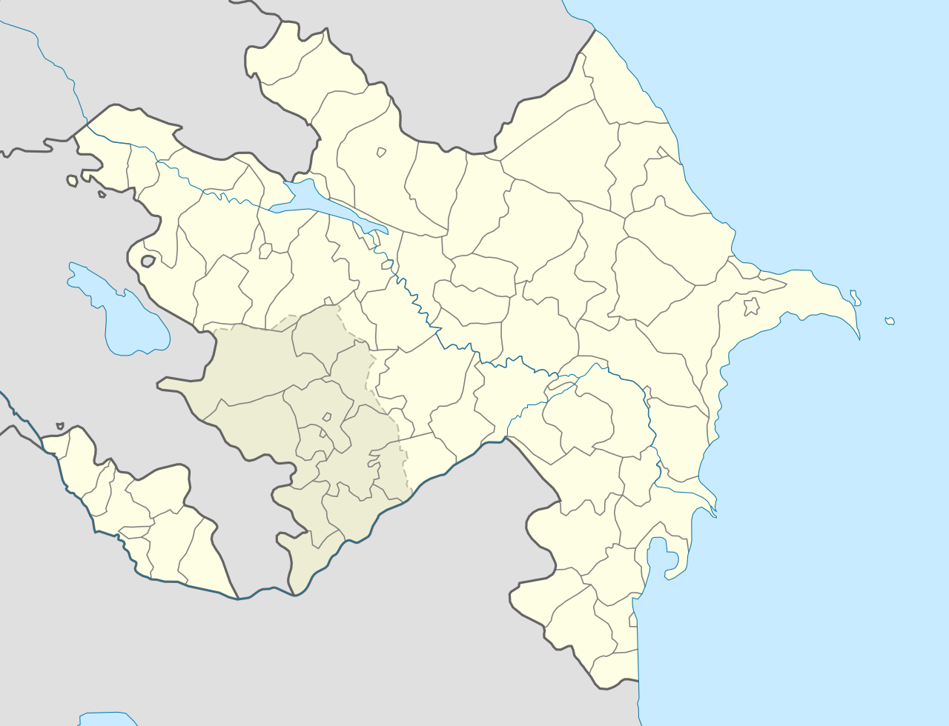
Khinalug

Slide 5
Khinalug negation patterns
The talk will focus on the negation of
predicative nouns
predicative adjectives
finite verbal tenses
imperative, voluntative, hortative, jussive
participles and other forms derived from them
attributed nouns and adjectives

Slide 6
Predicative nouns

Slide 7
Predicative nouns
The negative copula CL-i
hu mäˁlim-mä
cl1sg teacher-decl
“He is a teacher.”
hu mäˁlim y-i-mä
cl1sg teacher cl1sg-neg.cop-decl
“He is not a teacher.”

Slide 8
Predicative nouns
Spacial copula + negative copula CL-i
hu mäˁlim tʰo-mä
cl1sg teacher cop.far/even-decl
“He (far from speaker) is a teacher.”
hu mäˁlim tʰo-y-i-mä
cl1sg teacher cop.far/even-1sg-neg.cop-decl
“He (far from speaker) is not a teacher.”

Slide 9
Predicative adjectives

Slide 10
Predicative adjectives
Spacial copula (oa “above”, qoa “near/below”, tʰoa “far/even”) + negative copula CL-i
dä riši ħäyardä qo-mä
dp.2sg girl pretty cop.near/below-decl
“This girl is pretty.”
dä riši ħäyardä
dp.2sg girl pretty
qo-z-i-mä
cop.near/below-cl2sg-neg-decl
“This girl is not pretty.”

Slide 11
Predicative adjectives
Demonstrative in copula function + negative copula CL-i
dä riši ħäyardä dä-mä
dp.2sg girl pretty dp.cl2sg-decl
“This girl is pretty.”
dä riši ħäyardä dä-z-i-mä
dp.2sg girl pretty dp.cl2sg-cl2sg-neg-decl
“This girl is not pretty.”

Slide 12
Contraction and class marker drop
Demonstrative in copula function + negative copula CL-i
cl1sg di < du-yi
cl2sg dä-zi or di
cl3sg dä-vi
cl4sg ži < ži-yi
hpl (1+2) dur-vi
nhpl (3+4) ži or žitʰ-yi

Slide 13
Predicative adjectives
The negation CL-i loses it class marker
in combination with the non-spacial copula attä (short form: atʰ):
dä riši ħäyardä atʰ-mä
dp.2sg girl pretty be-decl
“This girl is pretty.”
dä riši ħäyardä atti-mä
dp.2sg girl pretty be:neg-decl
“This girl is not pretty.”

Slide 14
Finite verbal tenses

Slide 15
Finite verbal tenses
based on pfv.:
ptcp.pfv + spacial copula: spacially marked past
ptcp.pfv + non-spacial copula: spacially unmarked past
ptcp.pfv + proximal demonstrative: perfect
based on ipfv:
ptcp.ipfv + spacial copula: spacially marked present
ptcp.ipfv + non-spacial copula: spacially unmarked present
ptcp.ipfv + proximal demonstrative: future

Slide 16
Finite verbal tenses
Like in nominal predicates, the negative copula attaches to the element with copula function,
e.g. with spacial copula
(o “above”, qo near/below, tʰo “far/even”):
Alagöz soor
pn village:loc
kʰa-z-ɯʁ-qo-z-i-mä
come-2sg-come.pfv.ptcp-cop.near/below-2sg-neg-decl
“Alagöz did not come to the village.”

Slide 17
Finite verbal tenses
Like in nominal predicates, the negative copula attaches to the element with copula function,
e.g. with the non-spacial copula:
Yä dalɯg
I.erg work
kʰi-r-etti-mä
do.ipfv-ipfv-ptcp:cop:neg-decl
“I am not working.”
(kʰiri + atti => kʰiretti)

Slide 18
Finite verbal tenses
Like in nominal predicates, the negative copula attaches to the element with copula function,
e.g. with the non-spacial copula:
Yä dalɯg
I.erg work
kʰi-r-i-ži-mä
do.ipfv-ipfv-ptcp-dp.cl4sg:neg-decl
“I will not work.”

Slide 19
Tense forms with past marker -šä
based on pfv:
ptcp.pfv + spacial copula + šä: spacially marked plupast
ptcp.pfv + non-spacial copula + šä: spacially unmarked plupast
ptcp.pfv + proximal demonstrative + šä: pluperfect
based on ipfv:
ptcp.ipfv + spacial copula + šä: spacially marked imperf. past
ptcp.ipfv + non-spacial copula + šä: spacially unmarked imperf. past
ptcp.ipfv + proximal demonstrative + šä: irrealis

Slide 20
Tense forms with past marker -šä
Morpheme order in negation:
ptcp - copulative element – negation – -šä
šuqˣad-ɯr
stable-loc
lacʼɯ-zɯ-ʁ-dä-z-i-šä-mä
enter-cl2sg-enter.pfv-dp.cl2sg-cl2sg-neg-pst-decl
“She would not have entered the stable.”

Slide 21
Finite verbal tenses
Habitual present and habitual past have a different construction model:
ipfv.stem – petrified spacial element – ipfv.suffix
i.e., verb type dependent, -ta-r or -a-r

Slide 22
Finite verbal tenses
In negated habitual forms, the negative copula never has a class marker:
Ähmäd il dalɯg
pn here work
kʰi-tʰa-r-i-mä
do.ipfv-far/even-ipfv-neg-decl
“Ahmad does not work here.”
dä χinimkʼir hečʰ
dp.cl2sg woman neg.ptcl
χä-s-kʰin-tʰa-r-i-mä
laugh-cl2sg-laugh-far/even-ipfv-decl
“This woman never laughs.”

Slide 23
Imperative-like forms

Slide 24
Imperative-like forms
Verb stem forms in imperative-like forms and their negations are an ongoing matter of research
Different forms depending on verb type (acc. to imperfective formation) and, in one verb type, voice (transitive vs. intransitive)
Contradictive information given by speakers in elicitations especially
for intransitive verbs (most of which express unintentional actions and are thus hardly given as orders) and
for the ancient negated jussive in -si, which is hardly used any more and has been replaced by a periphrastic structure

Slide 25
Imperative-like forms
Imperative sg (negated with kʰu “do” + neg. copula)
pos. transitive V-a/ä neg. transitive: V-a/ä-kʰu-cl-i
pos. intrans. V-ɯl neg. intrans.: V-ɯl-ɯn-kʰu-cl-i
Imperative pl (negated with kʰu “do” + neg. copula)
pos. transitive V-eylun / V-eyluz neg. transitive V-ä-kʰu-cl:v-un/z
pos. intrans. V-ɯlun / V-ɯluz neg. intrans. V-ɯl-ɯn-kʰu-cl:v-un/z
Voluntative and Hortative excl.: (neg. cop directly at vol. suffix)
pos.: V-n-ä neg. V-n-ä-cl-i
Hortative incl. (neg. cop. at spacial copula)
pos. V-tʰoa / V-oa neg. V-tʰo-cl-i / V-o-cl-i
Jussive: (new: neg. cop. at spacial copula; old: neg. cop at -si (opaque))
pos. cl-ax V-tʰoa / V-oa neg.1 cl-ax V-tʰo-cl-i / V-o-cl-i
(cl-ax = ‘let’) neg.2 V-si-cl-i

Slide 26
Participles

Slide 27
Some additional info before talking about participles
Verbs can be classified according to the way they form their imperfective participle:
most common type:
ptcp.pfv = -i ptcp.ipfv = -r-i
rarest, assumably oldest type:
ptcp.pfv = -i ptcp.ipfv = -l-i or -z-i
verb stems with a stem extension in -n
ptcp.pfv = +n-i, ptcp.ipfv = +n-dä

Slide 28
Some additional info before talking about participles
Verbs can be classified according to the way they form their imperfective participle:
most common type:
ptcp.pfv = -i ptcp.ipfv = -r- i
rarest, assumably oldest type:
ptcp.pfv = -i ptcp.ipfv = -l-i or -z-i
verb stems with a stem extension in -n
ptcp.pfv = +n-i, ptcp.ipfv = +n-dä
in negated particpiles, the negative copula is formed according to the -n-i/-n-dä type!

Slide 29
Attributive Participles
Perfective participles:
likʼuvu-i kitab
read-ptcp.prf book
the book that has been / was read
likʼuvu-n-u-n-dä kitab
read-st.ex.“n“-neg.cop-st.ex.“n”-ipfv-ptcp book
the book that has not been / was not read

Slide 30
Attributive Participles
Imperfective participles:
dalɯg ki-r-i lɯgɯld
work do-ipfv-ptcp man
the man who works / is working / will work
dalɯg
work
ki-to-n-u-n-dä
do-cop.far/even-st.ext“n”-neg.cop-st.ext“n”-ipfv.ptcp
lɯgɯld
man
the man who does not work / is not working / will not work

Slide 31
Attributive Participles
Perfective:
Perfective stem
+ stem extension in –n
+ negative copula (vowel harmony!)
+ stem extension in –n
+ imperfective particple in –dä
Imperfective:
Imperfective stem
+ petrified spacial copula (to or o, verb-type triggered)
+ stem extension in –n
+ negative copula (vowel harmony!)
+ stem extension in –n
+ imperfective participle in -dä

Slide 32
Converbs derived from participles

Slide 33
Converbs derived from the ipfv.ptcp
Converbs expressing simultaneity with a process:
kʰi-tʰooruni < kʰi-tʰoa yo-r-uni
do.ipfv-cop.far/even-finite cop-ipfv-cvb.simul.1
“while doing” 1st option
kʰi-tʰonundä yoruni
negated participle + cop-ipfv-cvb.simul.1
“while not doing” 1st option

Slide 34
Converbs derived from the ipfv.ptcp
Converbs expressing simultaneity with a process:
kʰi-tʰooršuni < kʰi-tʰoa yo-r-šuni
do.ipfv-cop.far/even-finite cop-ipfv-cvb.simul.2
“while doing” 2nd option
kʰi-tʰonundä yo-r-šuni
negated participle + cop-ipfv-cvb.simul.2
“while not doing” 2nd option

Slide 35
Converbs derived from the pfv.ptcp
Converb expressing simultaneity with the endpoint
kʰu-i-sɯn
do.pfv-ptcp-cvb3
“when ... did”,
i.e. when the process of doing reached its endpoint
kʰu-n-u-n-dä-sɯn
negated participle-cvb3
“when ... did not do”
often with evidential or causal interpretation

Slide 36
Converbs derived from the pfv.ptcp
Converbs expressing condition
realis:
kʰu-i-qʼaʁɯllɯ kʰunundä-qʼaʁɯllɯ
pfv.participle-cvb4 negated pfv.participle-cvb4
“if ... does” “if... does not”
irrealis:
kʰui-qʼäšin kʰunundä-qʼäšin
pfv.participle-cvb5 negated pfv.participle-cvb5
“if ... had done” “if... had not done”

Slide 37
Unnegatable Converbs :
Clause chaining converbs (both at pfv and ipfv ptcp):
kiri-yä
do.ipfv-ipfv-ptcp-cvb4
“is / was doing and...”
kui-yä
do.pfv-ptcp-cvb4
“did / has done and... ”
Converbs expressing “until, before” (only at pfv):
kʰu-n-tʼɯ-n-nɯ
do-st.ext.“n”-inchoat.cop-st.ext.“n”-cvb5
“until doing, before doing”

Slide 38
Verbal nouns – Agent / Patient nouns

Slide 39
Verbal nouns – Agent / Patient nouns ptcp + proximal dp
kʰu-i-du
do.pfv-ptcp-dp.cl1sg
most logic interpretation as agent:
“the one who did”
kʰu-i-žitʰ
do.pfv-ptcp-dp.nhpl
most logic interpretation as patient:
“the things that were done”

Slide 40
Agent or patient noun: ptcp + proximal dp
ki-r-i-du
do.ipfv-ptcp-dp.cl1sg
most logic interpretation as agent:
“the one who does / is doing / will do”
ki-r-i-žitʰ
do.ipfv-ptcp-dp.nhpl
most logic interpretation as patient:
“the things that are (being) done, will be done”

Slide 41
Negation of agent / patient nouns
ptcp + prox.dp -> neg.ptcp + prox.dp
pfv.:
kʰui-du -> kʰunundä-du
kʰui-žitʰ -> kʰunundä-žitʰ
ipfv.:
kʰiri-du -> kʰitʰonundä-du
kʰiri-žitʰ -> kʰitʰonundä-žitʰ

Slide 42
Converbs derived from A / P nouns

Slide 43
Converbs derived from A / P nouns
Converbs can be derived from the non-human oblique stems of agent / patient nouns –sä by attaching a case suffix:
ptcp.pfv-vn(a/p)-comparative -qʼilli: since (endpoint) ptcp.ipfv-vn(a/p)-comparative -qʼilli: since (beginning)
ptcp.ipfv-vn(a/p)-similative -ččini: as, to the extent of
ptcp.ipfv-vn(a/p)-dative -u: in order to
ptcp.ipfv-vn(a/p)-adelative -x: in order to
or by attaching a postposition that governs a case:
ptcp-pfv-vn(a/p)-adel -x + tʰotʰux “after”: after

Slide 44
Negation of converbs derived from A / P nouns
negative participle + same structure as non-negated verbal a/p nouns

Slide 45
Action nouns
Participle + suffix -val (< loan from Lezgic)
kʰui-val kʰiri-val
pfv.participle-vn ipfv.participle-vn
“having done X” “doing X”
kʰunundä-val kʰitʰonundä-val
neg. pfv.participle-vn neg. ipfv.participle-vn
“not having done X” “not doing X”

Slide 46
Negation of attributed nouns and adjectives

Slide 47
Negation of attributed nouns and adjectives
The interplay of 11 copulative elements and existential verbs of the finite system is reduced to 5 negative copulas that are used for the negation of attributed non-verbal elements.
place-related negation:
mäʕlim tonundä ǯigä
teacher be:neg.ptcp place
“a place where there is no teacher”
possession-related negation:
cʼu at-tonundä ħädmi
name prev-be:neg.ptcp person
“a person that has no name”

Slide 48
Negation of attributed nouns and adjectives
The interplay of 11 copulative elements and existential verbs of the finite system is reduced to 5 negative copulas that are used for the negation of attributed non-verbal elements.
availability-related negation:
hinä-χ čʼonundä pɯl
dp.dist.obl-ad be:neg.ptcp money
“the money that he does‘nt have at his disposal”
negated attributive noun:
mäʕlim konundä ħädmi
teahcer be:neg.ptcp person
“a person who is not a teacher”

Slide 49
Negation of attributed nouns and adjectives
The interplay of 11 copulative elements and existential verbs of the finite system is reduced to 5 negative copulas that are used for the negation of attributed non-verbal elements.
negated attributive adjective:
ħäyardä yonundä riši
pretty be:neg.ptcp girl
“a girl who is not pretty”
The copula that yonundä is derived from is only attested in two relicts:
negated participle (see above)
yo- (< yi + spacial o) in the negated converb
V.ipfv-(tʰ)onundä-yo-r-šuni

Slide 50
Negation of attributed nouns and adjectives
ptcp.ipfv neg. ptcp.ipfv
kui k-onundä preverb k + copula
tüi t-onundä preverb t + copula
čʼi čʼ-onundä preverb čʼ + copula
*yi y-onundä petrified cl1/4 + copula

Slide 51
Negation of attributed nouns and adjectives
ptcp.ipfv neg. ptcp.ipfv
kui k-onundä preverb k + copula
tüi t-onundä preverb t + copula
čʼi čʼ-onundä preverb čʼ + copula
*yi y-onundä petrified cl1/4/nhpl + copula
How can cl-i be both positive copula and negative copula???

Slide 52
Cl-i: positive vs. negative copula
Relict of *yi in the verb “to love”
ptcp neg. ptcp
cl1/4/nhpl y-i-qʼi/ y-i-kui y-onundä
cl-cop-be.pfv / cl-cop-be.ipfv
cl2 r-iži-zi-qʼi, r-iži-kui r-ižonundä
cl-cop+X-cl-be.pfv / cl-cop+X-be.ipfv
cl3/hpl b-iži-bi-qʼi, b-iži-kui b-ižonundä
cl-cop+X-cl-be.pfv / cl-cop+X-be.ipfv
Ancient class marker system with r- = cl2 and plosive before vowel in cl3/hpl
Less ancient class marker system negative copula: 1/4/nhpl y-i, 2 z-i, 3/hpl v-i
Hypothesis (more research needed): These two cl-i elements appeared in Khinalug in different eras, and spread over syntactic positions in a way that ambiguity is excluded.

Slide 53
Summary
The negative copula is
cl-i imperative forms and in tense forms based on spacial copulas
cl-i or contracted to i without cl in tense forms based on proximal demonstrative
i without class marker in tense forms based on attä and in habitual forms in -tʰar / -ar
indä (following the paradigm of the n-dä verb type) in the stem negation of participles

Slide 54
Thank you for your attention

