Slide 1
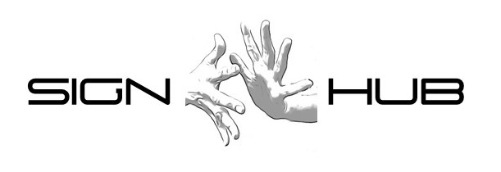
Typological Aspects of Negation in Sign Language of the Netherlands
VIII Syntax of the World’s Languages Paris, 05-09-2018
Ulrika Klomp, Marloes Oomen & Roland Pfau

Slide 2
Overview
Introduction & Methodology
Position of the basic clause negator
Negative modals
Neg-raising
Conclusions

Slide 3
– 1 – Introduction & Methodology

Slide 4
Sign Language Negation
Has been studied for a fair number of SLs (Zeshan 2004, 2006a; de Vos & Pfau 2015).
Identification of patterns that are common across SLs, as well as interesting cross-linguistic variation (Zeshan 2004; Pfau 2015).
Descriptive/typological studies as well as formal approaches.

Slide 5
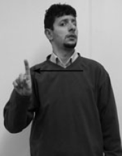
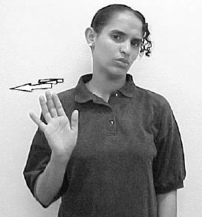
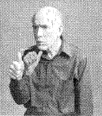
Manual Markers of Negation
All SLs studied to date employ manual elements (particles) and non-manual markers in the expression of negation.
Turkish SL (Zeshan 2004: 28)
Jordanian SL (Hendriks 2008: 80)
American SL (Fischer 2006: 187)

Slide 6
Non-manual Markers (NMMs)
Generally, NMMs may fulfil functions at all levels of grammar (Pfau & Quer 2010).
Most common NMM for negation: headshake.
NMMs, like manual markers, can be traced back to (culture-specific) co-speech gestures (Kendon 2002).
Yet, the cross-linguistic evidence suggests that these gestures grammaticalize in SLs (Van Loon et al. 2014; Pfau 2015).

Slide 7
Variation Across Sign Languages
Despite superficial similarities, SLs differ in
basic position of manual negative particle;
obligatoriness of manual negative particle;
scope of the non-manual marker;
availability of Negative Concord;
availability of negative modals.
(Pfau & Quer 2002; Zeshan 2004, 2006a; Quer 2012; Pfau 2016)

Slide 8
Sign Language of the Netherlands
Previous studies have established:
that NGT allows for both SOV- and SVO-orders;
that use of headshake is obligatory in negative contexts;
that the headshake may spread;
that a manual negative particle is optional in NGT.
(Coerts 1992, 1994; van Gijn 2004; Oomen & Pfau 2017)

Slide 9
Data
Naturalistic corpus data from Corpus NGT (Crasborn, Zwitserlood & Ros 2008)
92 deaf signers in dialogue setting
2375 recordings, partially annotated
Dialogues, narratives, elicitation tasks
Informants
Two deaf signers
Informal grammaticality judgments

Slide 10
– 2 – Position of the Basic Clause Negator

Slide 11
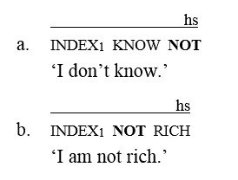
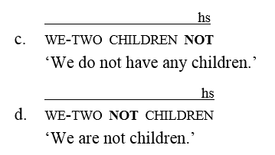
Position of not in SLs
In some SLs, position of manual negator is fixed (e.g. Catalan SL (Pfau & Quer 2002); Italian SL (Geraci 2005)).
In other SLs, position may vary depending on
verbal vs. non-verbal predicate, e.g. Swedish SL (a/b);
possessive vs. standard reading, e.g. Norwegian SL (c/d).
(Bergman 1995: 87; Vogt-Svendsen 2000)

Slide 12
Position of not in NGT
Analysis of 117 negated clauses in Corpus NGT; 47 clauses with manual negative sign (Oomen & Pfau 2017).
No difference between verbal and non-verbal predicates.
Different positions do not yield different readings.
 | Order | N | %
Post-VP | (S)-(O)-V-not | 29 | 61.7%
 | (S)-V-O-not | 2 | 4.3%
Pre-VP | (S)-not-(O)-V | 12 | 25.5%
 | Other | 4 | 8.5%

Slide 13
Constituent Order: O-V-not

Slide 14
Constituent Order: S-not-V

Slide 15
– 3 – Negative Modals

Slide 16
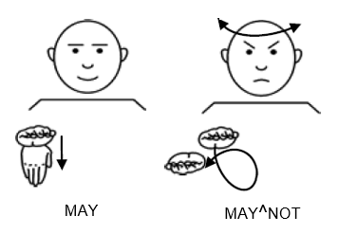
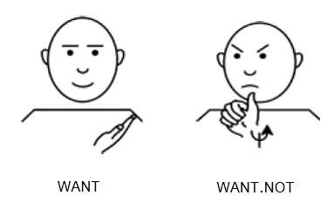
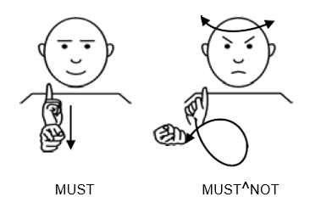
Negative Modals in SLs
Across SLs, the use of special negative forms of modal verbs is very common; e.g. cliticization and suppletion (Zeshan 2004).
(German SL; Pfau & Quer 2007)

Slide 17
Modals: Strategies for Negation
Negative modals
Modal + not
Modal + headshake only?

Slide 18
Negative Modals in NGT
Cannot, may-not, want-not, need-not

Slide 19
Modal + not
It is also possible to use a combination of a modal and the manual negative particle not:
Contradicts Pfau & Quer’s (2007) claim that use of specialized forms – when available – is obligatory.

Slide 20
Modal + Headshake Only?
According to informants, this strategy is ungrammatical.
However, we found a handful of examples in the Corpus NGT:

Slide 21
– 4 – Neg-raising

Slide 22
Neg-raising – The Phenomenon
In Neg-raising (NR – also ‘negative transport’), a matrix negation can be interpreted in the embedded clause (e.g. Horn 2001; Zeijlstra 2017).
Confined to certain (cognitive) predicates, such as think, believe, expect; compare (1) and (2).

Slide 23
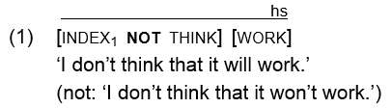
NR in Sign Languages
NR is mentioned, but not discussed, in Zeshan’s (2004) typological study.
In fact, to date, NR has only been described for Australian SL (Johnston 2018):
(Australian SL; Johnston 2018: 218)

Slide 24
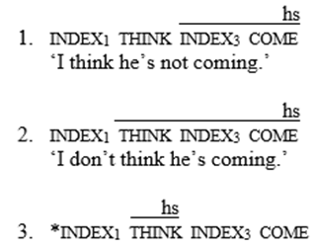
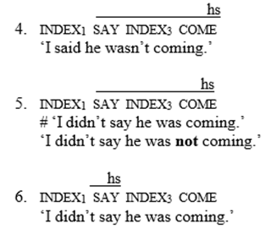
Neg-raising in NGT
Informants:
With NR predicates, the headshake may accompany the main verb but must accompany the embedded clause.
With regular predicates, headshake over both the main and embedded clause entails double negation.

Slide 25
Neg-raising in NGT (2)
Corpus data:
By and large confirm spreading patterns:
However, we found at least one clear counterexample:
“I don’t believe [he understands [what we’re saying]]”
“I don’t know [if that’s right]”

Slide 26
– 5 – Conclusions

Slide 27
Conclusions
As with other SLs, NGT employs both manual and non-manual means to express negation.
The manual negator not can occur both before and after the VP.
Specialized negative modals exist, but modal + not, and possibly modal + headshake can also be used.
NR constructions have distinct headshake spreading patterns.

Slide 28
Acknowledgements
We wish to thank our informants.
Dutch Science Foundation (NWO); grant #360-70-520 (Marloes Oomen).
European Union’s Horizon 2020 research and innovation programme (SIGN-HUB); grant no. 693349 (Ulrika Klomp).

Slide 29
References
Aboh, Enoch O. 2010. C-type negation markers on the right edge. In Enoch O. Aboh & James Essengby (eds.), Topics in Kwa syntax. Dordrecht: Springer, 109–139.
Bauer, Anastasia. 2014. The use of space in a shared sign language of Australia. Berlin: De Gruyter Mouton.
Bergman, Brita. 1995. Manual and nonmanual expression of negation in Swedish Sign Language. In Heleen Bos &Trude Schermer (eds.), Sign language research 1994. Hamburg: Signum, 85–103.
Coerts, Jane. 1992. Nonmanual grammatical markers: An analysis of interrogatives, negations and topicalisations in Sign Language of the Netherlands. Amsterdam: University of Amsterdam. Doctoral dissertation.
Coerts, Jane. 1994. Constituent order in Sign Language of the Netherlands. In Mary Brennan & Graham H. Turner (eds.), Word-order issues in sign language. Durham: International Sign Linguistics Association, 47–70.
Crasborn, Onno, Inge Zwitserlood & Johan Ros. 2008. Het Corpus NGT: Een digitaal open access corpus van filmpjes en annotaties van de Nederlandse Gebarentaal. Nijmegen: CLS, Radboud Universiteit Nijmegen. www.ru.nl/corpusngt.
Fischer, Susan D. 2006. Questions and negation in American Sign Language. In Ulrike Zeshan (ed.), Interrogative and negative constructions in sign languages. Nijmegen: Ishara Press. 165–197.
Notes:
Pfau, Roland. 2015. The grammaticalization of headshakes: From head movement to negative head. In Andrew D.M. Smith, Graeme Trousdale & Richard Waltereit (eds.), New directions in grammaticalization research. Amsterdam: John Benjamins, 9–50.

Slide 30
Geraci, Carlo. 2005. Negation in LIS (Italian Sign Language). North East Linguistic Society 35. 217–229.
van Gijn, Ingeborg. 2004. The quest for syntactic dependency: Sentential complementation in Sign Language of the Netherlands. Amsterdam: University of Amsterdam. Doctoral dissertation.
Gökgöz, Kadir. 2011. Negation in Turkish Sign Language: The syntax of nonmanual markers. Sign Language & Linguistics 14. 49–75.
Hendriks, Bernadet. 2007. Negation in Jordanian Sign Language: A cross-linguistic perspective. In Pamela Perniss, Roland Pfau & Markus Steinbach (eds.), Visible variation: Cross-linguistic studies on sign language structure. Berlin: Mouton de Gruyter, 104–128.
Horn, Laurence R. 2001. A natural history of negation. Stanford: CSLI Publications.
Johnston, Trevor. 2018. A corpus-based study of the role of headshaking in negation in Auslan (Australian Sign Language): Implications for signed language typology. Linguistic Typology 22(2). 185–231.
Kendon, Adam. 2002. Some uses of the head shake. Gesture 2. 147–182.
van Loon, Esther, Roland Pfau & Markus Steinbach. 2014. The grammaticalization of gestures in sign languages. In Cornelia Müller et al. (eds.), Body – language – communication: An international handbook on multimodality in human interaction, Vol. 2. Berlin: De Gruyter Mouton. 2133–2149.
Makharoblidze, Tamar & Roland Pfau. 2018. A negation-tense interaction in Georgian Sign Language. Sign Language & Linguistics 21(1). 136–151.
Notes:
Pfau, Roland. 2015. The grammaticalization of headshakes: From head movement to negative head. In Andrew D.M. Smith, Graeme Trousdale & Richard Waltereit (eds.), New directions in grammaticalization research. Amsterdam: John Benjamins, 9–50.

Slide 31
Neidle, Carol, Judy Kegl, Dawn MacLaughlin, Benjamin Bahan & Robert Lee. 2000. The syntax of American Sign Language: Functional categories and hierarchical structure. Cambridge, MA: MIT Press.
Oomen, Marloes & Roland Pfau (2017). Signing not (or NOT): A typological perspective on standard negation in Sign Language of the Netherlands. Linguistic Typology 21(1). 1–51.
Pfau, Roland. 2015. The grammaticalization of headshakes: From head movement to negative head. In Andrew D.M. Smith, Graeme Trousdale & Richard Waltereit (eds.), New directions in grammaticalization research. Amsterdam: John Benjamins, 9–50.
Pfau, Roland (2016). Non-manuals and tones: A comparative perspective on suprasegementals and spreading. Linguistica 11. 19–58.
Pfau, Roland & Josep Quer. 2002. V-to-Neg raising and negative concord in three sign languages. Rivista di Grammatica Generativa 27. 73–86.
Pfau, Roland & Josep Quer. 2007. On the syntax of negation and modals in Catalan Sign Language and German Sign Language. In Pamela Perniss, Roland Pfau & Markus Steinbach (eds.), Visible variation: Cross-linguistic studies on sign language structure. Berlin: Mouton de Gruyter, 129–161.
Pfau, Roland & Josep Quer. 2010. Nonmanuals: Their grammatical and prosodic roles. In Diane Brentari (ed.), Sign languages. Cambridge: Cambridge University Press, 381–402.
Quer, Josep. 2012. Negation. In Roland Pfau, Markus Steinbach & Bencie Woll (eds.), Sign language: An international handbook. Berlin: De Gruyter Mouton. 316–339.
Notes:
Pfau, Roland. 2015. The grammaticalization of headshakes: From head movement to negative head. In Andrew D.M. Smith, Graeme Trousdale & Richard Waltereit (eds.), New directions in grammaticalization research. Amsterdam: John Benjamins, 9–50.
Gökgöz, Kadir. 2011. Negation in Turkish Sign Language: The syntax of nonmanual markers. Sign Language & Linguistics 14. 49–75.

Slide 32
Vogt-Svendsen, Marit. 2000. Negation in Norwegian Sign Language and in contrast to some features in German Sign Language. Presentation at 7th International Conference on Theoretical Issues in Sign Language Research (TISLR 7), Amsterdam, July 2000.
de Vos, Connie & Roland Pfau. 2015. Sign language typology: The contribution of rural sign languages. Annual Review of Linguistics 1. 265–288.
Zeijlstra, Hedde. 2017. Does NEG-Raising involve NEG-Raising? Topoi: An International Review of Philosophy 37(3). 417–433.
Zeshan, Ulrike. 2004. Hand, head, and face: Negative constructions in sign languages. Linguistic Typology 8. 1–58.
Zeshan, Ulrike. 2006a. Negative and interrogative constructions in sign languages: A case study in sign language typology. In Ulrike Zeshan (ed.), Interrogative and negative constructions in sign languages. Nijmegen: Ishara Press. 28–68.
Zeshan, Ulrike. 2006b. Negative and interrogative structures in Turkish Sign Language (TİD). In Ulrike Zeshan (ed.), Interrogative and negative constructions in sign languages. Nijmegen: Ishara Press. 128–164.
Notes:
Pfau, Roland. 2015. The grammaticalization of headshakes: From head movement to negative head. In Andrew D.M. Smith, Graeme Trousdale & Richard Waltereit (eds.), New directions in grammaticalization research. Amsterdam: John Benjamins, 9–50.

Slide 33
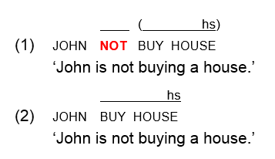
American SL vs. Turkish SL
American SL: basic word order SVO; negator not precedes VP (1); headshake is obligatory and may spread; use of not is optional (2).
ASL is a non-manual dominant SL.
(Neidle et al. 2000)

Slide 34
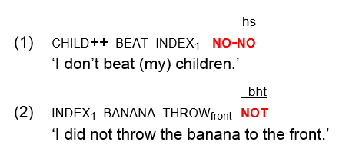
American SL vs. Turkish SL
Turkish SL: basic word order SOV; manual negator clause-final; use of manual negator is obligatory; NMM (headshake (1) or backward head tilt (2)) only accompanies manual Neg.
Turkish SL is a manual dominant SL.
(Zeshan 2006b; Gökgöz 2011)

Slide 35
Cross-linguistic Patterns
Non-manual dominant S-VP-Neg (e.g. Catalan SL)
Manual dominant S-VP-Neg (e.g. Italian SL)
Non-manual dominant S-Neg-VP (e.g. American SL)
Manual dominant S-Neg-VP (Yolngu SL?)
(Pfau & Quer 2002; Geraci 2005; Neidle et al. 2000; Bauer 2014)

Slide 36
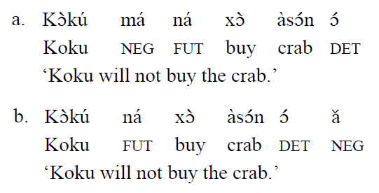
Cross-linguistic Comparison: Fongbe
Fongbe exhibits the preverbal negator má which precedes tense (a), as well as the clause-final marker ă (b) → no difference in interpretation.
(Aboh 2010: 248)

Slide 37
Suppletion
German SL
(Pfau & Quer 2007)
Georgian SL
(Makharoblidze & Pfau 2018)

